Slide 1

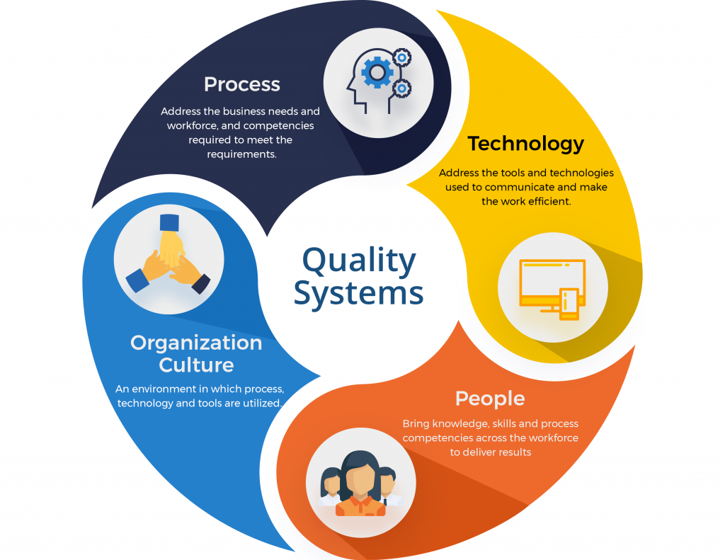
Unit: 5
Quality System (CO5)
A quality management system (QMS, alternatively “quality system”) is a mechanism for managing and continuously improving core processes to “achieve maximum customer satisfaction at the lowest overall cost to the organization”.

Slide 2
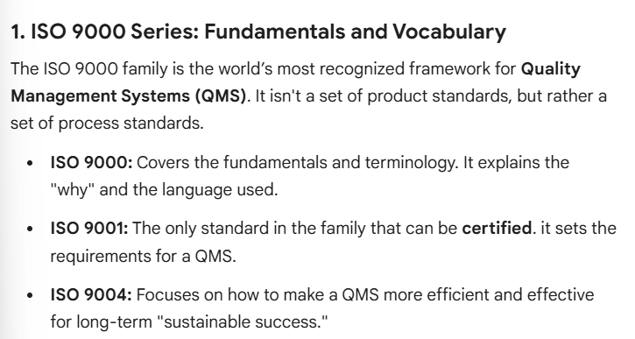

Slide 3
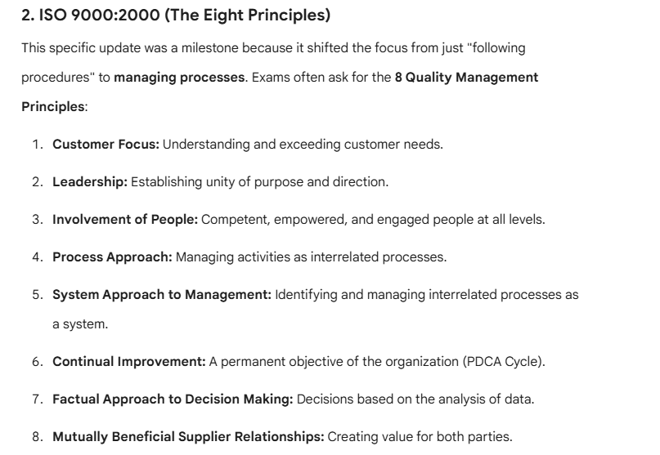

Slide 4
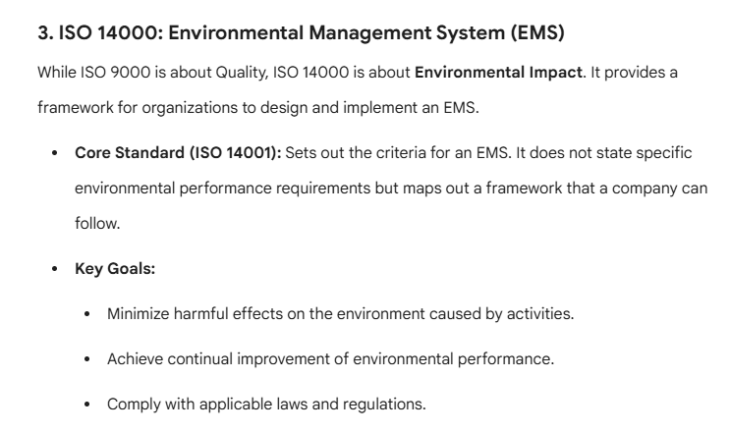

Slide 5
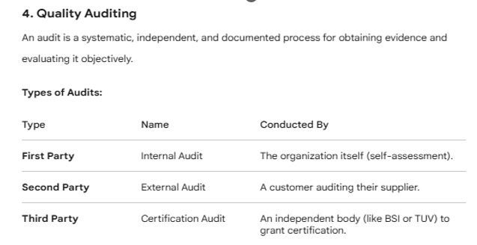
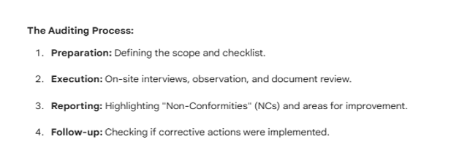

Slide 6
